Slide 1
Charging station for iec / iso 15118 protocol
Jiztom Francis k 311113106022
Nivas gokul m 311113106040
Supervisor
Mr. I suman Maria tony, M.Tech
ASST. PROFESSOR

Slide 2
objective
To design and develop a Human Machine Interface(HMI) for an electric car charging station running on ISO 15118 protocol and interface it with the Electric Vehicle Supply Equipment (EVSE) using a standard communication protocol.
It should also :
Detect and lock-in the power charging cable.
Communicate between the charging station and the touch screen device.
Display real time charging process.

Slide 3
Conditions to be followed:
Another platform should be used to run and interface the HMI as the EVSE does not have enough resources to run additional programs.
The EVSE should be a client and should have the code modified in minimal invasive method.
The three devices should simultaneously run when the specified conditions are satisfied.
Should satisfy all the state and event condition as mentioned in the OpenV2G project.

Slide 4
task
The main task is to implement a basic working model of the car charging station with the HMI interfaced into the system. It involves the study of the basic working of the ISO 15118 protocol and defining the possible working structure of the Charging station.
Analyse the requirements of ISO 15118 and IEC 61851 based on the work of the references.
Design, discuss and finalize the state machine and the communication process between EVSE and HMI Learn about UML as a description language for state machines and communication sequences

Slide 5
Task – cont…
Use TCP/IP communication between the Raspberry pi and EVSE to send information between HMI and EVSE.
Write Software program based on C language to interface the HMI and the EVSE as a backend process.
Implement the entire task to a fully functional final product.

Slide 6

Literature survey

Slide 7
Sl. NO | Paper/Reference Details | Outcome | Inference
1. | Peter Hank, Steffen Müller, Ovidiu Vermesan, Jeroen Van Den Keybus, ‘Automotive Ethernet: in-vehicle networking and smart mobility’, DATE '13 Proceedings of the Conference on Design, Automation and Test in Europe Pages 1735-1739 | The basic guide line on how to approach the charging with vehicle to grid communication | Required details and model construction of the ISO 15118 smart charging model

Slide 8
Sl. NO | Paper/ Reference Details | Outcome | Inference
2 | B O Chen , Keith S. Hardy, Jason D. Harper, Daniel S. Dobrzynski , ‘ Towards standardized Vehicle Grid Integration’ , Transportation Electrification Conference and Expo (ITEC) ,2015 ,IEE. | A basic introduction on the ISO15118 and its relationship with the Smart Grid Network | The overview of the ISO 15118 model and its performance aspect
3 | Dr. Andreas Heinrich, Michael Schwaiger, Daimler Ag and BMW group, ‘ISO 15118 – charging communication between plug-in electric vehicles and charging infrastructure’, Grid Integration of Electric Mobility, 1st international ATZ Conference 2016, pp 213-227 | Specifications on the proposed plans for ISO 15118 | The technical specifications

Slide 9
Sl. NO | Paper/Reference Details | Outcome | Inference
4 | M. Sc. Michael Tybel, Dr. –Ing Andrey Popov, Dr. –Ing Michael Schugt , Scienlab electronic systems, Bochum, ‘Assuring Interoperability between Conductive EV and EVSE Charging Systems’, Popov.com. | The basic guide line on how to approach the charging with vehicle to grid communication | Required details and model construction of the ISO 15118 smart charging model
5 | D. Wellisch, J Lenz, A Faschingbauer, R. Posch, S. Kunze, Deggendorf Institute of Technology, Freyung. Research gate Publication, ‘Vehicle-to-grid AC charging Station’ An Approach for Smart Charging Development.’

Slide 10
methodologies

Slide 11
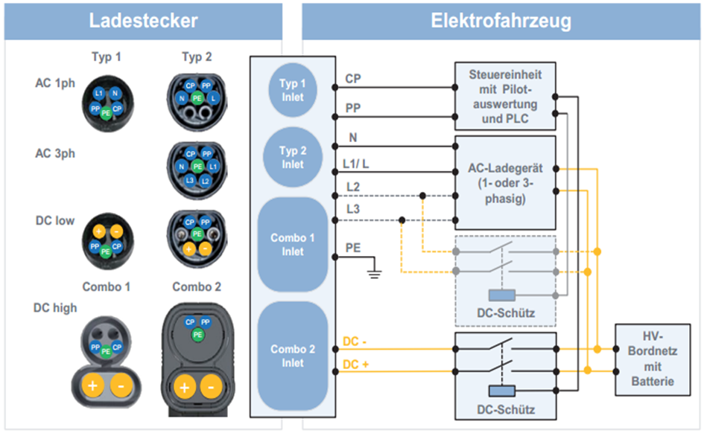
IEC 62196: VEHICLE PLUG

Slide 12
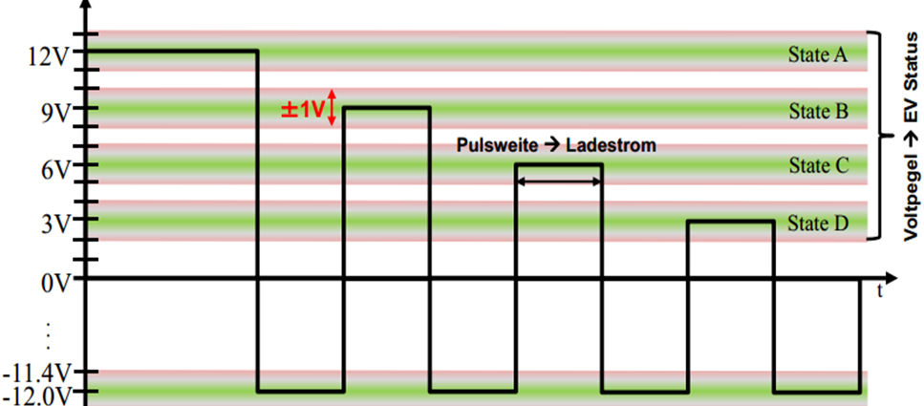
IEC 61851
The standard adopts the IEC 61851 definition for a signal pin that switches the charging current - the charging station remains de-energized until an electric vehicle is connected. During the charging process, the vehicle cannot be put into operation.

Slide 13
Level | State | Condition Description
12 ± 1 V | State A | Electric vehicle is not connected
9 ± 1 V | State B | connected electric vehicle, not charging Ready
6 ± 1 V | State C | connected electric vehicle, ready to charge
3 ± 1 V | State D | connected electric vehicle, ready for loading, ventilation needed
0 ± 1 V | State E | Network problem, PP Short to earth
-12V | State F | Vehicle unavailable Error

Slide 14
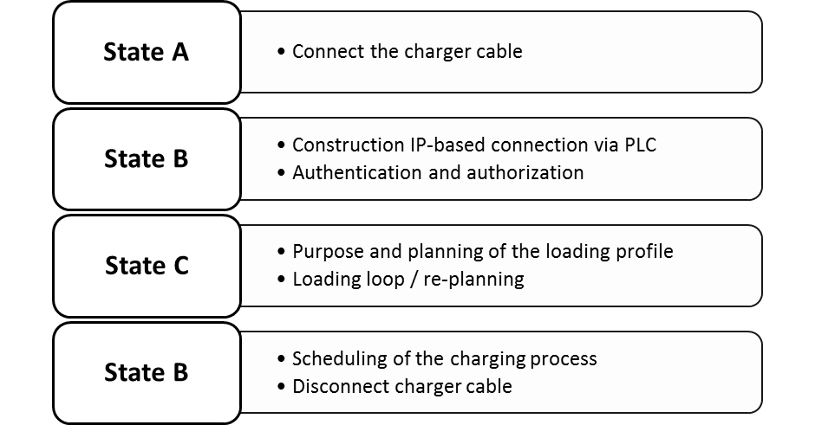
ISO 15118

Slide 15
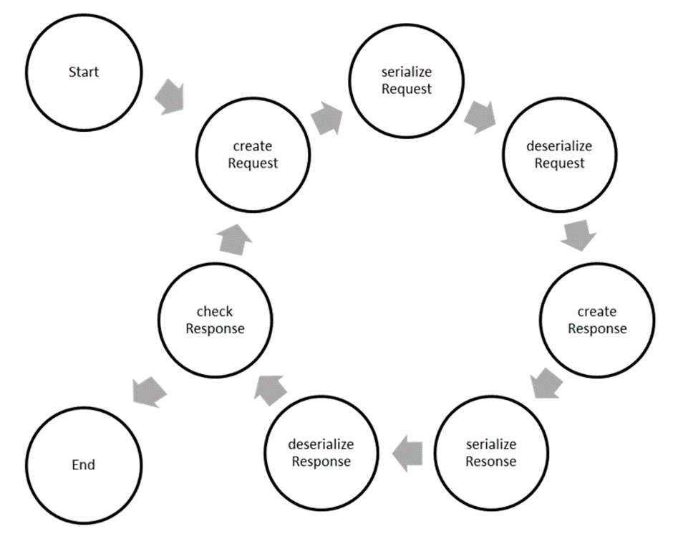
OPENV2G PROJECT

Slide 16
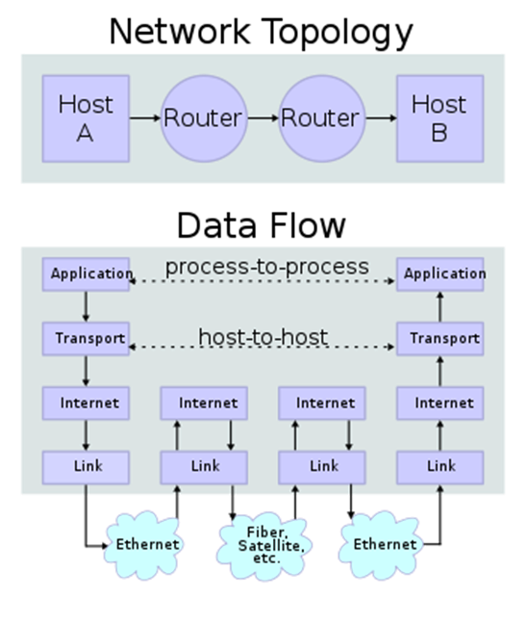
TCP/IP COMMUNICATION

Slide 17
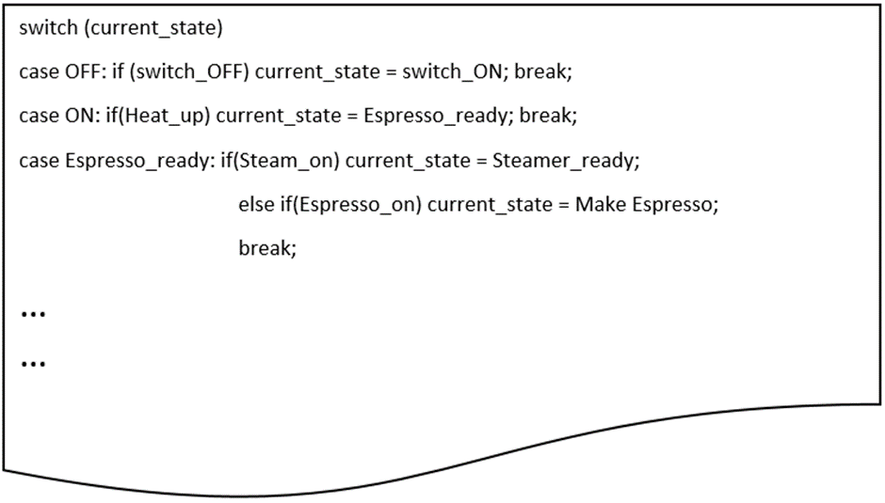
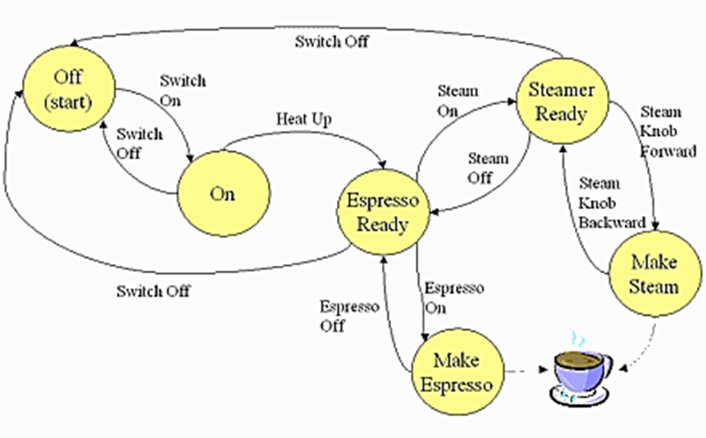
AUTOMATIC STATE DIAGRAM

Slide 18
Software description

Slide 19
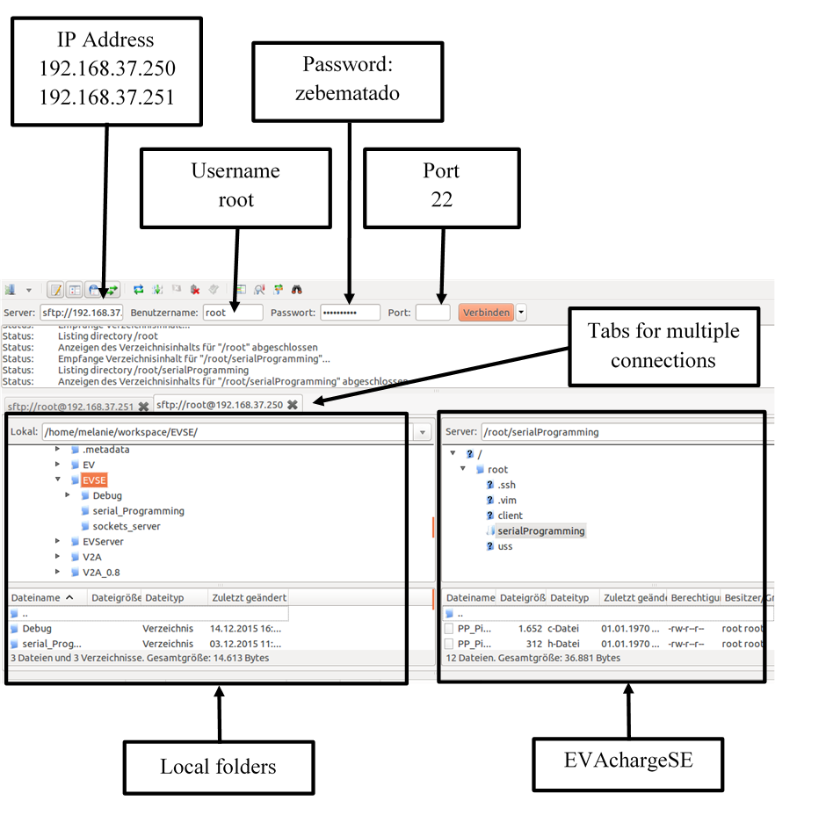
filezilla

Slide 20
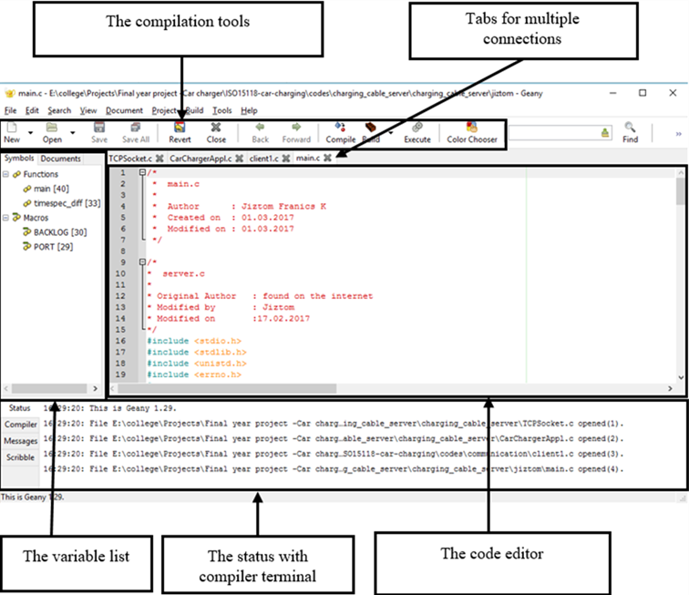
geany

Slide 21
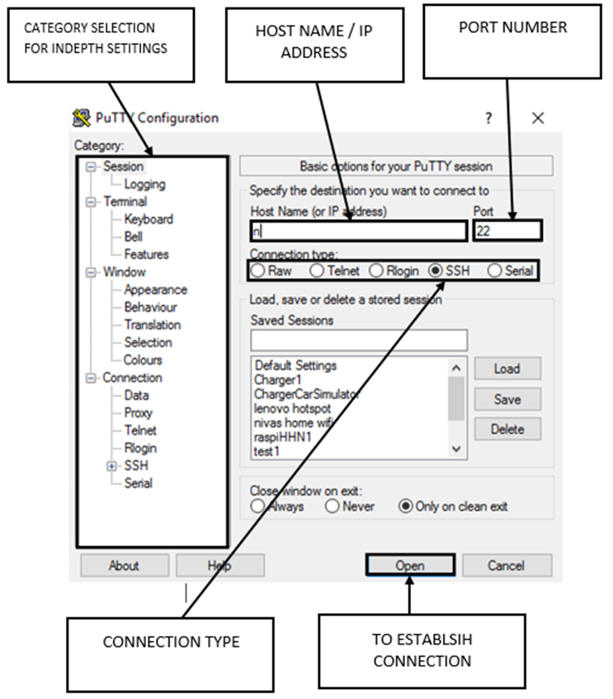
pUtty terminal

Slide 22
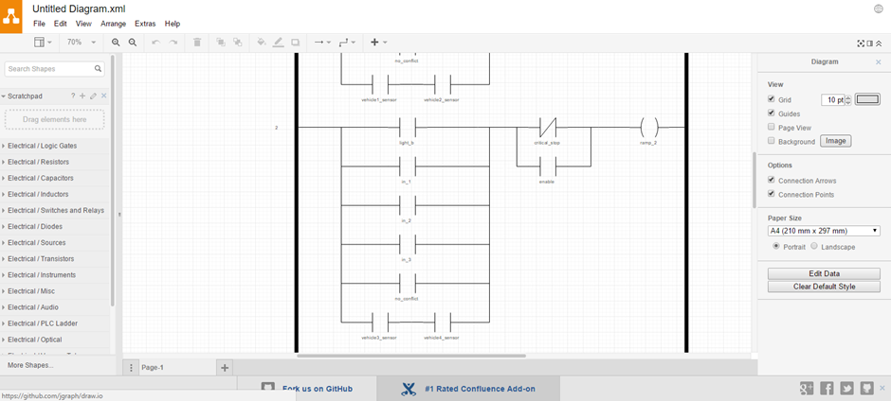
draw.io

Slide 23
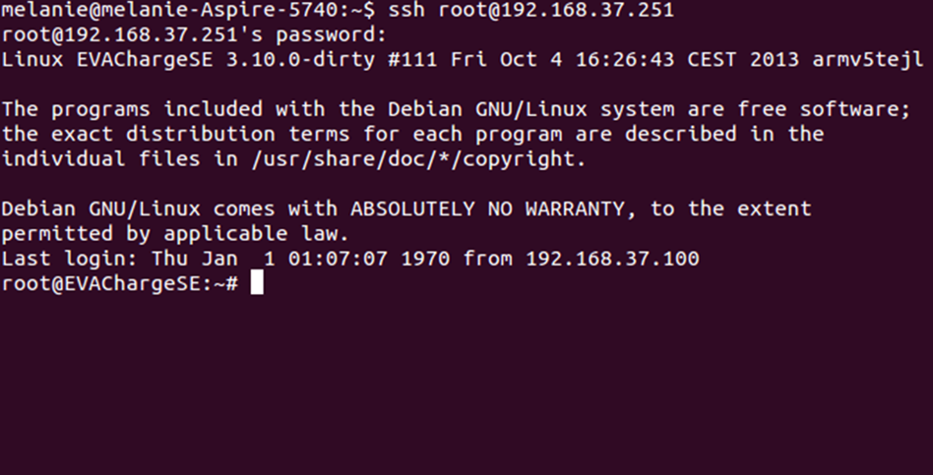
COMPILING THE PROGRAM

Slide 24
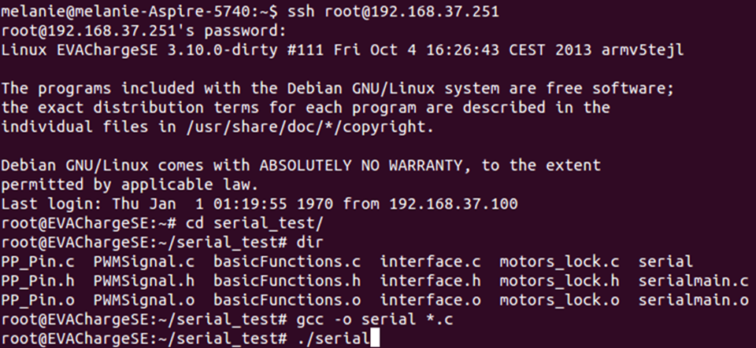

Slide 25
General Nutshell commands | Explanation
ssh root@192.168.37.250 | Establishing a secure shell connection
sftp root@192.168.37.250 | Connection setup of an SFTP protocol
ifconfig | Configuration and status display of all available network interfaces
cd <Ordnername> | Change Directory: To a subdirectory of the current folder
cd .. | Change to parent directory
cd /home/user | Change to the / home / user file
vi <Dataname> | Open a file in the vi editor. To return to the terminal from the editor, press "ESC", enter ": q" and confirm with Return.
gcc –o <NAME> *.c | Compile of all source files accordingly
./<NAME> | Starting from a program accordingly
ping <IP-address> | Sends data packets to an IP address to check the presence of a connection
ping –I qca0 <IP-Address> | Ping command over network interface qca0
dir | Displays all folders and files in the current directory.
pwd | Returns current folder path
rm <Data> | Delete a file

Slide 26
Hardware description

Slide 27
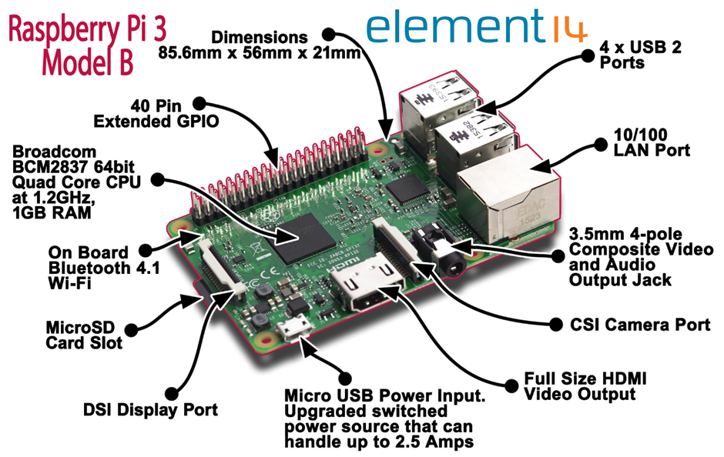
Raspberry pi3

Slide 28
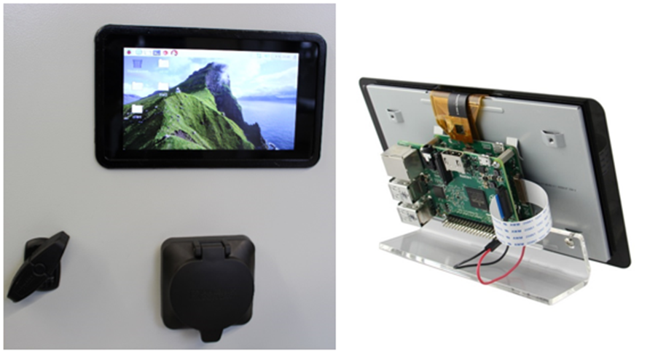
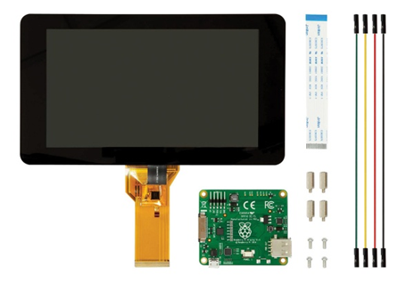
Raspberry pi 7” official touch screen

Slide 29
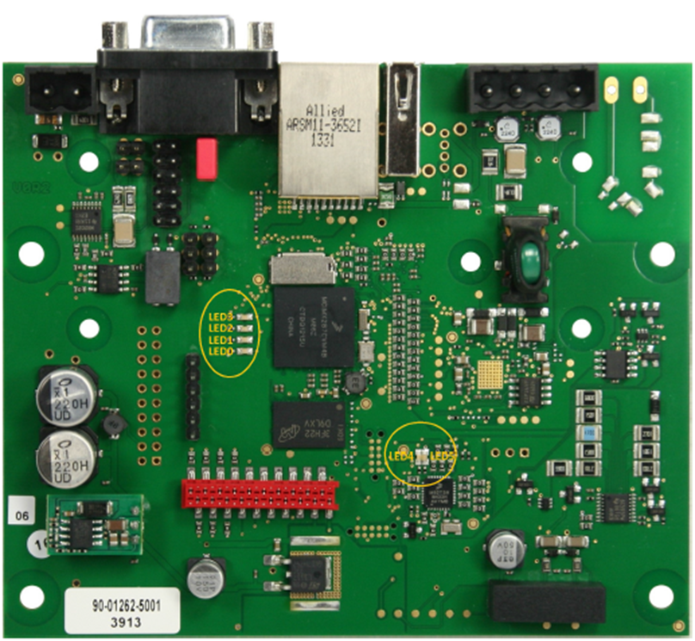
Evacharge se

Slide 30
Parameter | Value
Power Supply | 12 V
Power Consumption | Max. 4 W (2.6 W in idle mode) - Plus Power for USB devices
Temperature range | -40 °C to +85 °C
Air humidity | 95% rel. humidity (non-condensing)
Outline Dimension | 100mm x 120 mm x 20 mm
Weight | 92g
RoHS | EVACharge SE is manufactured RoHS compliant

Slide 31
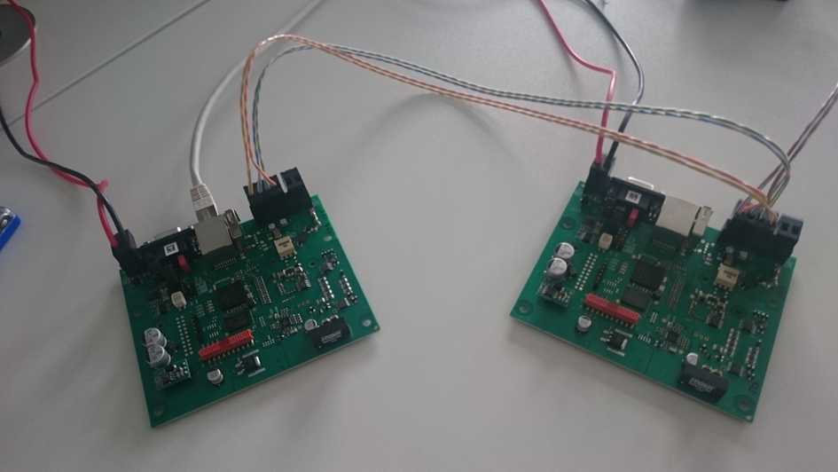

Slide 32
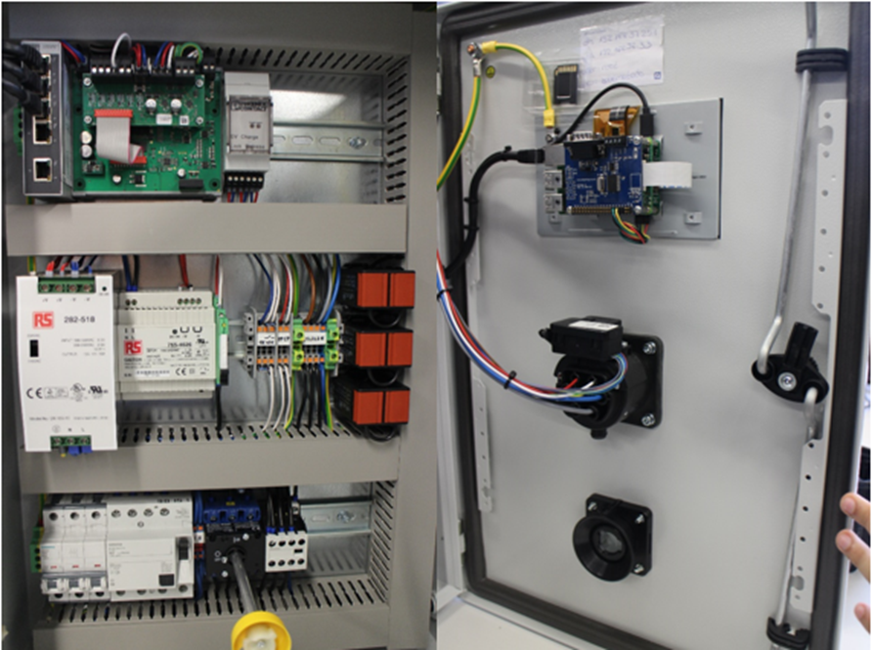

Slide 33
Model architecture and operations

Slide 34
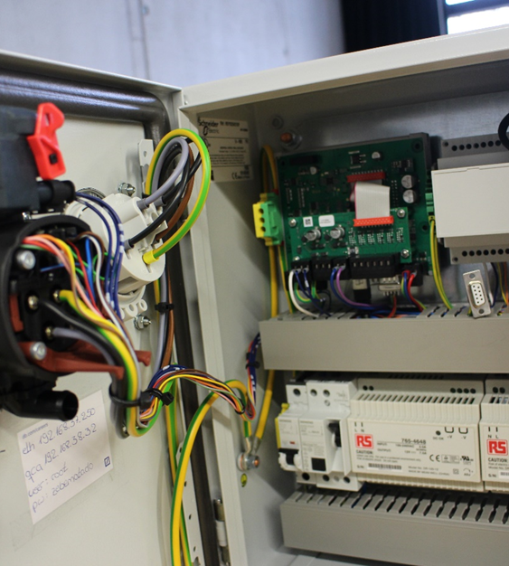
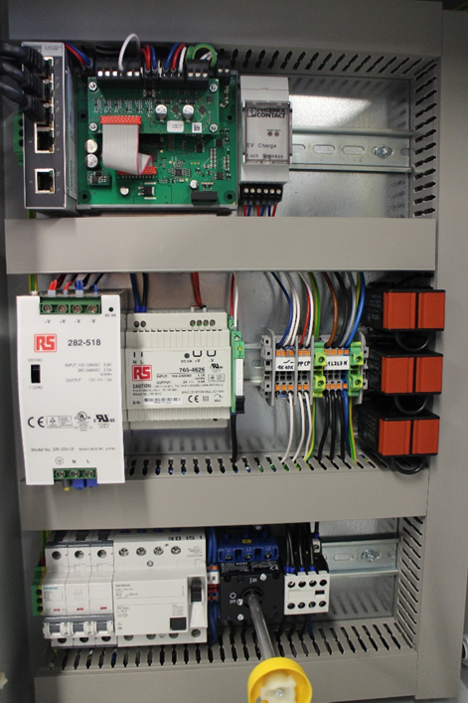
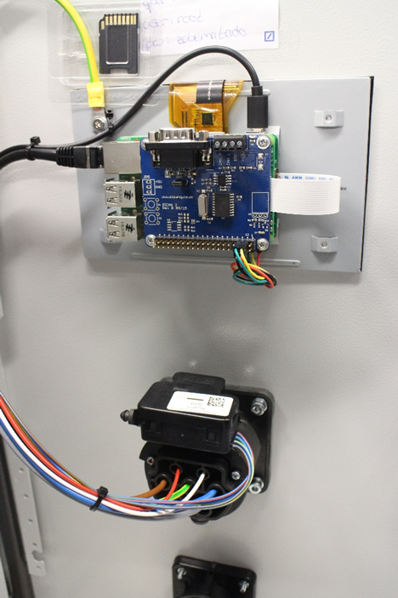
Hardware setup
EV module
EVSE module
Raspberry pi module

Slide 35
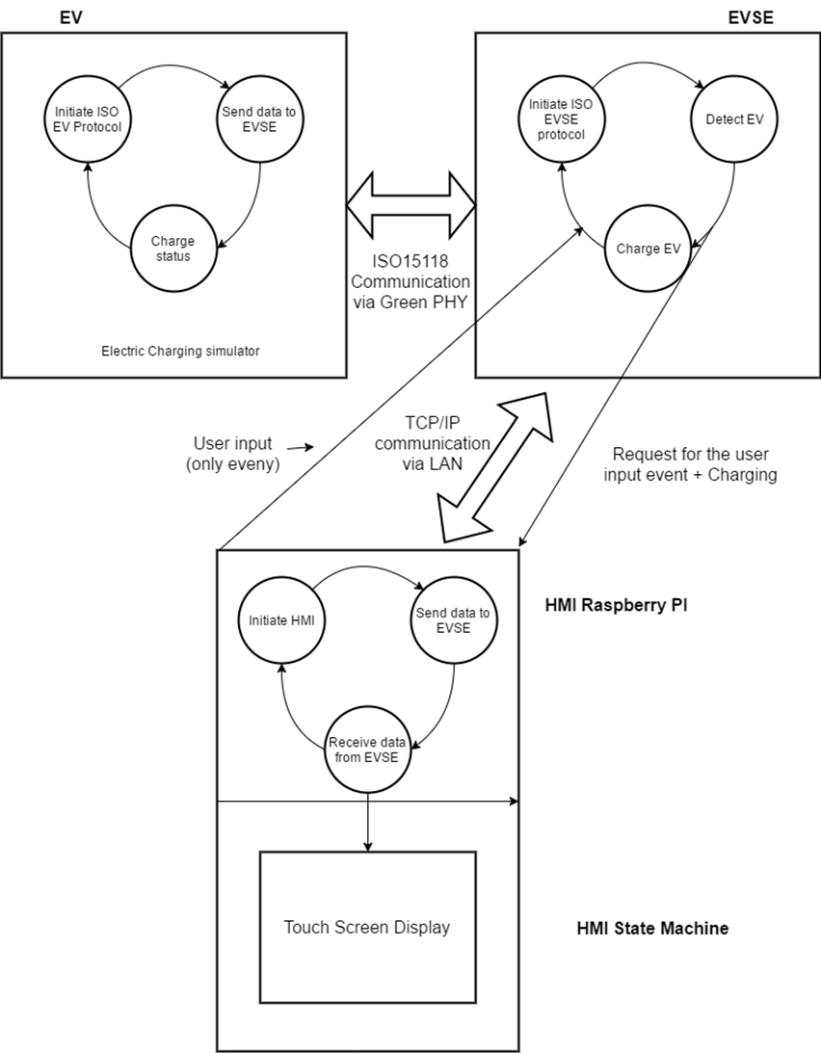

Slide 36

Block diagrams

Slide 37
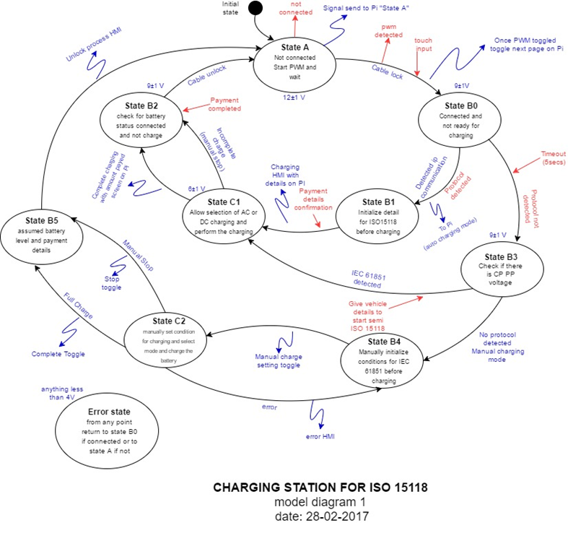

Slide 38
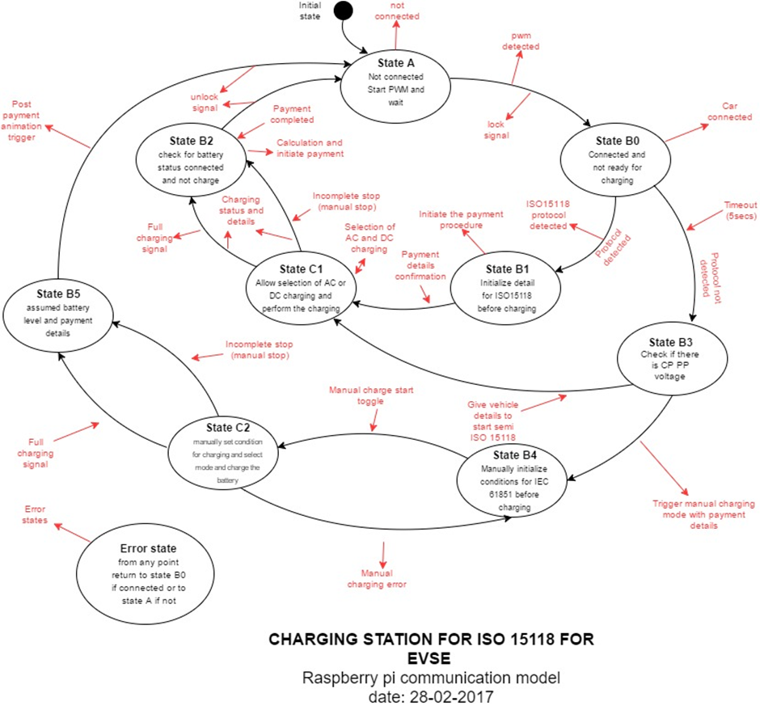

Slide 39
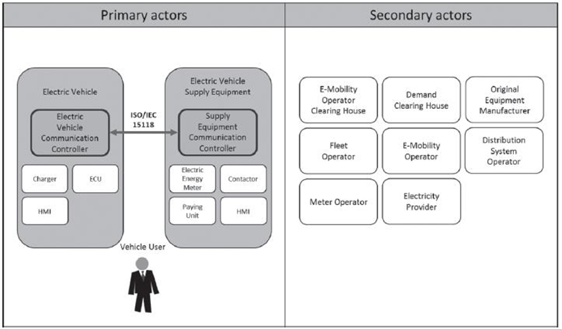
Iso/IEC 15118 actors

Slide 40
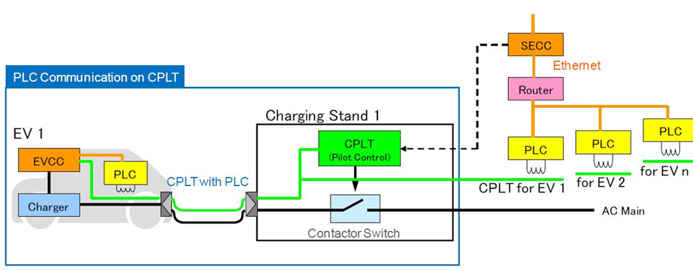
Plc communication on control pilot line (cplt)

Slide 41
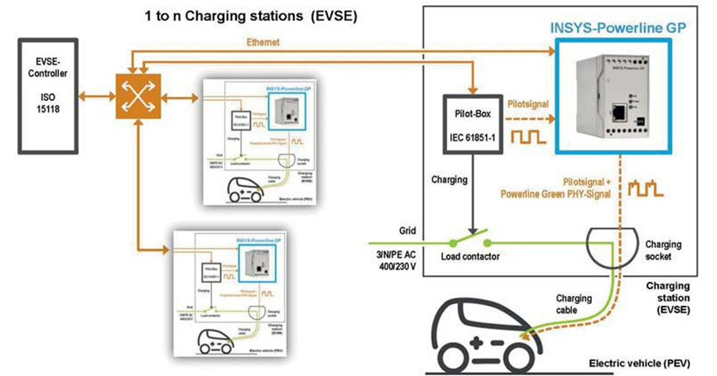
The insys power line gp as a commercial solution

Slide 42
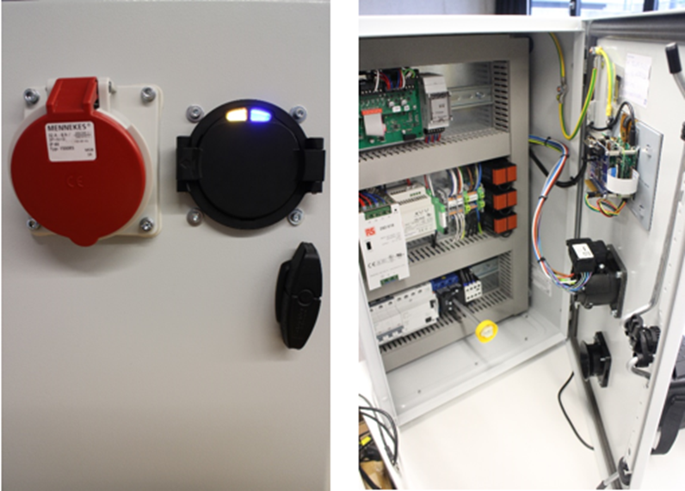
result

Slide 43
conclusion

Slide 44
reference

Slide 45

Protocols being used
A brief abstract on the protocols being used in the project.

Slide 46
Abstract - ISO/IEC 15118-1:2013
ISO 15118 specifies the communication between Electric Vehicles (EV), including Battery Electric Vehicles and Plug-In Hybrid Electric Vehicles, and the Electric Vehicle Supply Equipment (EVSE). As the communication parts of this generic equipment are the Electric Vehicle Communication Controller (EVCC) and the Supply Equipment Communication Controller (SECC), ISO 15118 describes the communication between these components. Although ISO 15118 is oriented to the charging of electric road vehicles, it is open for other vehicles as well.
ISO 15118-1:2013 specifies terms and definitions, general requirements and use cases as the basis for the other parts of ISO 15118. It provides a general overview and a common understanding of aspects influencing the charge process, payment and load levelling.
ISO 15118 does not specify the vehicle internal communication between battery and charging equipment and the communication of the SECC to other actors and equipment (beside some dedicated message elements related to the charging). All connections beyond the SECC, and the method of message exchanging are considered to be out of the scope as specific use cases.

Slide 47
Abstract – IEC 61851-1: 2010 :
IEC 61851-1:2010 applies to on-board and off-board equipment for charging electric road vehicles at standard a.c. supply voltages (as per IEC 60038) up to 1 000 V and at d.c. voltages up to 1 500 V, and for providing electrical power for any additional services on the vehicle if required when connected to the supply network. It includes characteristics and operating conditions of the supply device and the connection to the vehicle; operators and third party electrical safety, and the characteristics to be complied with by the vehicle with respect to the a.c./d.c. EVSE, only when the EV is earthed.

Slide 48
Advantages/Applications of the proposed system
Allows for larger pool of electric cars and reduce the no. of fossil fuel based cars.
Allows for better control of the spikes at peak hours which may cause blackouts or overloads.
Safer and faster charging with comfortable interface.

